Slide 1


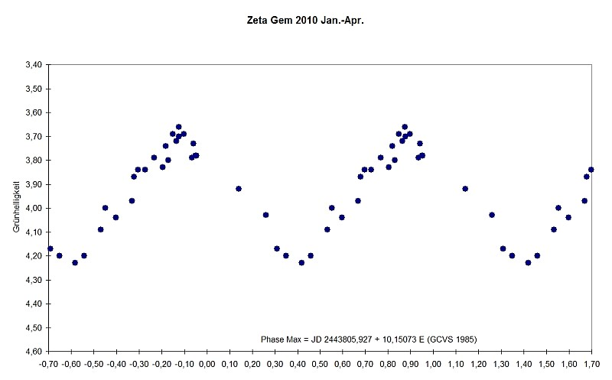
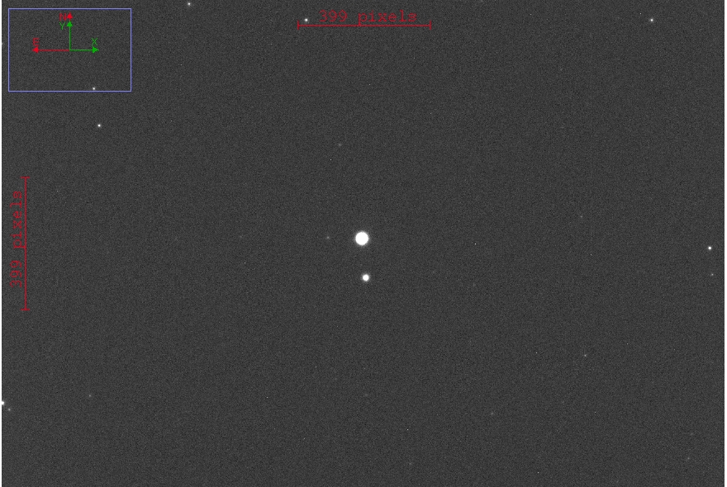
Variable stars:
ever changing lights
By: Steven Baskerville
sabaske@hotmail.com
Mechanical Engineering
Science, Discovery and the Universe
What are Variable Stars
My Research and Its Importance
Variable Stars are stars that vary their brightness over a period of time. This effect happens due to properties that the star has itself, such as rotating or changing in size, or things that externally effect the star, like stars in binary systems. Astronomers take a series of pictures over long periods o time in order to create a graph of the stars brightness over time. This data is used to determine its period, what type of variable it is, and occasionally, how far away the star is.
I have been collecting data at the UMD observatory on a star called Zeta Geminorum. Zeta Geminorum is a Classical Cepheid variable in the constellation Gemini. The fact that it is a Cepheid variable means that we can determine, fairly accurately, the distance to that star. I attempted to observe this star in order to recreate the processes that other researchers used to get the data in the first place. If the data I collected was accurate enough I could submit my findings to help update the information about the star.
Zeta Geminorum Light Curve Graph
Properties found from light curve
Period: 10.15 Days
Max Mag.: 4.18
Min Mag.: 3.62
Variable type: Classical Cepheid
Distance: 1,183 ly (light years)
*Information retrieved from AAVSO (American Association of Variable Star Observers)
Photo taken from: http://members.aon.at/wolfgang.vollmann/var/zeta_gem.htm
Picture of Zeta Gem
Conclusion
Zeta Geminorum has a period of ten days, but I was only realistically able to observe for a max of three or four hours a night. The data I collected ended up being a very small portion of the light curve and I was not able to generate a full light curve with the data I was able to collect. Astronomers must be dedicated and have a large amount of time to devote to observing in order to collect useful data. Unfortunately I did not have the means to attain such a level of devotion.
Photo cr. S. Baskerville
Acknowledgements to Elizabeth Warner, curator of the UMD observatory

