Slide 1
Theoretical work on Cosmology and Structure Formation
Massimo Ricotti

Slide 2
Current PhD Students
Mia Bovill (Where are the Fossils of the first galaxies?)
KwangHo Park (simulations of accretion onto IMBH with rad transfer)
Emil Polinsesky (Simulations of the Milky Way in CDM and WDM)
Kari Helgason (First light from IR background fluctuations, in collaboration with Alexander Kashlinsky)
Available for 2nd year projects
But at the moment I cannot support additional RAs

Slide 3
First structures in the Universe
Galaxy formation in early universe
Radiative/chemical feedback
Near field Cosmology
Dark matter simulations
Reionization of the intergalactic medium
Ly-alpha forest
Sources of reionization: role of GCs and X-rays
Primordial BHs and CMB

Slide 4
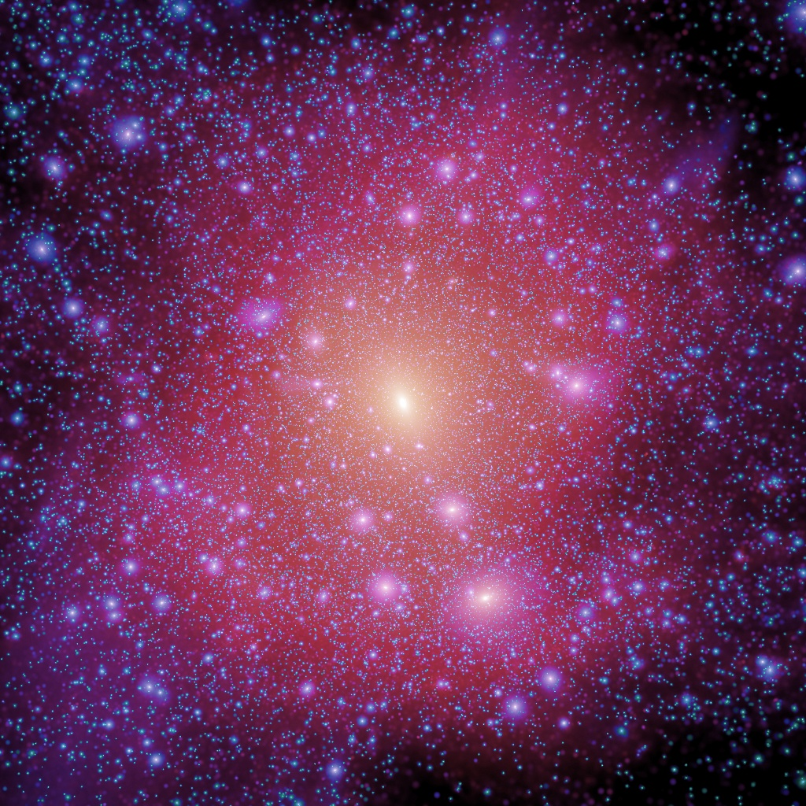
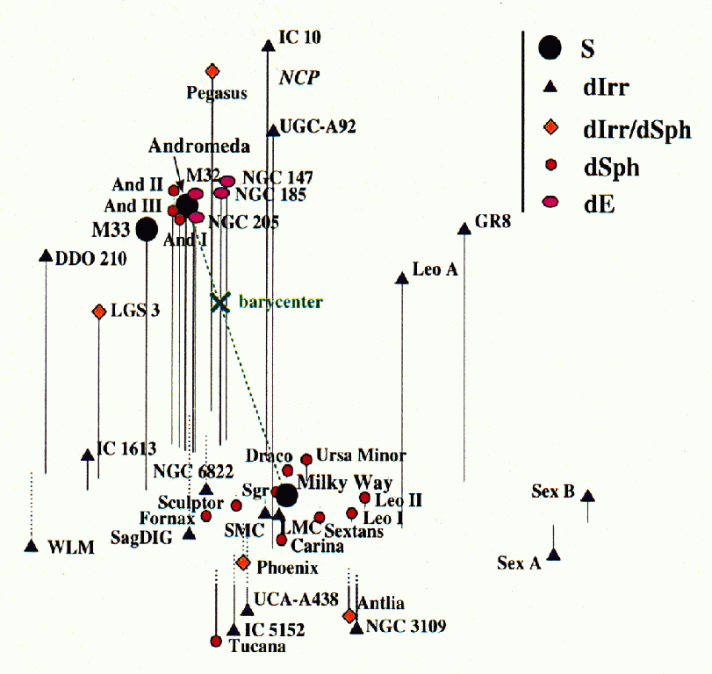
The Missing Satellites
Klypin et al 1999, More et al 1999
Figure credit: Grebel
There should be thousands of dwarf satellites around the Milky Way.
However, as of 2005 only about 30 satellites known in LG.
Aquarius Simulation (Springel et al, 2008)

Slide 5
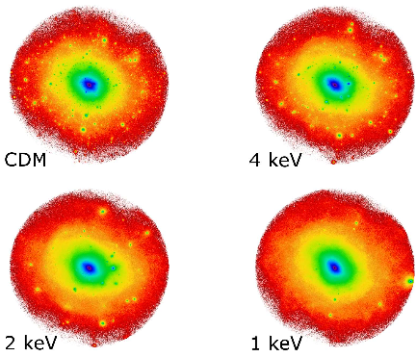
Less satellites if dark matter is warm
Polisensky & Ricotti 2010
Imposing:
N_{sat}(WMD simulation)≥N_{sat}(observed)
-> we can set limits on warmness of DM and thus the mass of WDM particle
Results:
If WDM is a thermal relic
m_{wdm}>2 keV
If WDM is a sterile neutrino
m_{s}>11 keV
This method is staring to become competitive and complementary with methods using Lyman-alpha forest (eg, Viel et al 2006, 2008) due to the recent discovery of many new MW satellites

Slide 7
Simulations of the first galaxies
Feedback-regulated galaxy formation
1 Mpc box size
10³ M_{sun} mass res.
3D radiative transfer
Run ends at redshift of reionization
Ref: Ricotti, Gnedin & Shull 2002

Slide 8
Properties of pre-reionization dwarfs
At z=10
Luminous galaxies
Pre-reionization
dwarfs
Fraction of cosmic baryons
Dark
galaxies

Slide 9
Pre-reionization fossils and ultra-faint dSphs: a model prediction!
Ref: Ricotti & Gnedin 05, Bovill & Ricotti 09

Slide 10
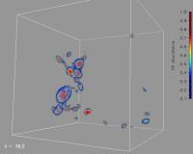
Hybrid Initial Conditions
The final pre-reionization output is transformed in a 1 Mpc³ box of particles.
We duplicate this box, adding perturbations to account for density variations with l > 1 Mpc.
Each HR particle in the resulting N-body simulation represents a pre-reionization halo.
Unique IDs allow us to retrieve the stellar properties at z = 0.

Slide 11
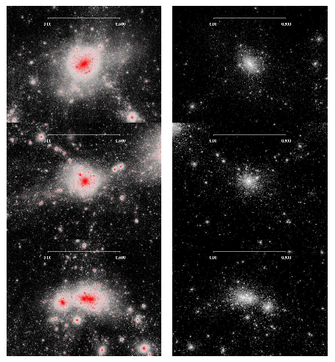

Slide 13
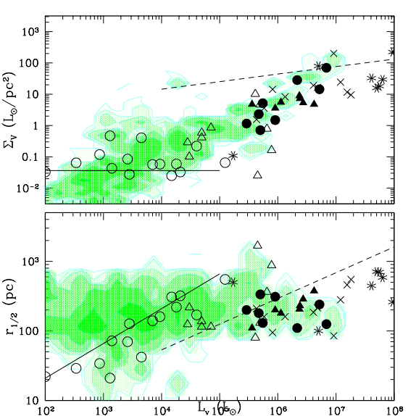
We now have z=0 halos which reproduce the faintest and smallest ultra-faints!
Yet undiscovered population

Slide 14
Reionization feedback on dwarf galaxy formation
The reionization feedback idea is valid but fails at z<2 if the halo is highly concentrated
Minihalos virialized before reionization, that evolve to z=0 in the low-density IGM, have a late phase of gas accretion and possibly star formation
Do these objects exist? ➔

Slide 15
Late gas accretion onto mini-halos
Z_{vir}=10
Ref: Ricotti 2008

Slide 16
Sources of Reionization
Role of globular clusters
X-ray pre-ionization: redshifted X-ray background
Accretion onto intermediate mass black holes with radiation feedback (KwangHo Park)
Primordial black holes

Slide 17
Bondi accretion with radiation feedback
Park & Ricotti 2010
100 M_{solar} IMBH
Gas density
Ionization fraction

Slide 18
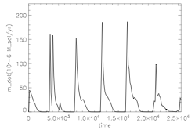
Accretion rate
Park & Ricotti 2010
See also Milosavljevic et al 2008

Slide 20
Preliminary results Moving BH + Radiative Feedback

Slide 21
Primordial black holes
PBHs modify recombination history and produce spectral distortions and anisotropies
New upper limits on f_{pbh} with WMAP3
PBHs promote formation of primordial H₂ and ﬁrst stars
Ultracompact minihalos as MACHOs

Slide 22
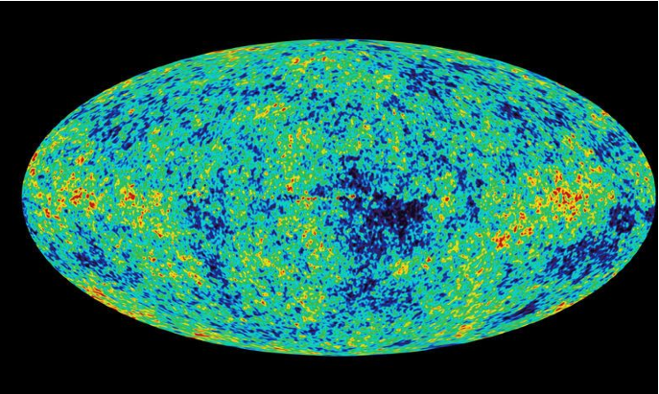
CMB anisotropies: WMAP3

Slide 23
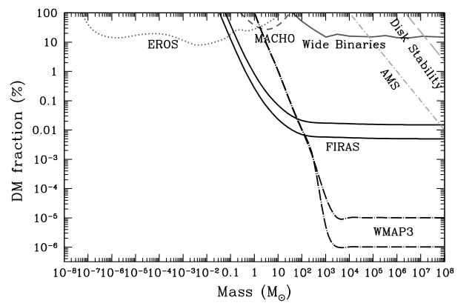
Constraints on f_{pbh} from WMAP 3

